Slide 1
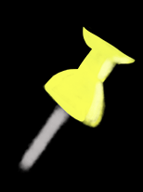
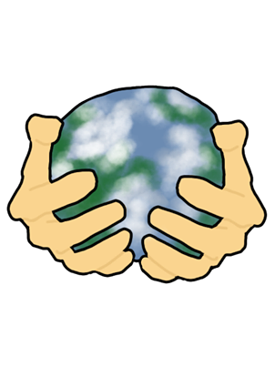
Personal social responsibility
Aim of the research
RESULTS AND ANALYSIS OF THE RESEARCH
Conclusions, limitations and future research plans
As part of the global world, we live in the conditions of social, economic and environmental problems and in this regard, social responsibility is of special importance. A prevalent issue in today’s society is people’s social consciousness and the tendency to overlook their own contributions to a problem.
The aim of this research is to bring awareness to personal social responsibility and to find out the extent to which we are accountable for the wellbeing of our community and environment.
The decisions we make and the actions we take today will reflect on future generations. It’s about our personal behavior as citizens, consumers, workers, neighbors or family members. We hope to show how each one of us is able to make a change. After all, a puzzle cannot be put together without all the pieces.
Personal Social Responsibility is “the way a person performs in his daily life as a member of the society – and not only as a consumer – basing his decisions in a desire to minimize the negative impacts and maximize the positive impacts on the social, environmental and economic environment in the long run” (Davis, S. et al., 2017).
From the results, based on the responses of our survey, we can conclude that most of the people in our community seem to be socially conscious and make active efforts to reduce waste by reusing materials, to save water and energy, to protect the environment, to care about people in need, etc.
Although the answers evidence comparatively positive attitude towards social issues, resources and time are advised to be spend on educating more people about the need of social responsibility and the fact that our social wellbeing depends on our actions and the change should start form us.
Despite the number of more than 1000 completed surveys received, we could disclose that they were completed by a relatively small sample of the population, which could lead to inaccurate results. It could be assumed that if we were to target a wider sample of people for our research, the findings might be slightly different.
In the future, in order to obtain more precise information, we could improve the collection of data by distributing the survey to a wider sample of people.
Based on our research we deduced that it’s not a widely discussed matter. There are unexplored opportunities within this topic and we hope to bring attention to them.
Most of the participants claimed that they have taken part in volunteering activities before. Majority of the people that gave a negative answer said that they would want to participate, but do not know where and how to.
Most of the people have answered that they stop their water, while brushing their teeth.
Surprisingly only 0,4% have answered that they don’t pay attention and 52,6% say that they don’t leave the lightbulb on.
Most of the respondents would rather travel with private vehicle (44,6%) and least with a bike (2,7%).
93,8% of respondent said they would find a place and a way to plant the tree given to them.
Methodology
The methods undertaken to conduct the research are collection of primary and secondary data.
Target group: people of all ages and background.
The primary research was carried out by the means of an online anonymous survey, created in Google Forms.
Posts to groups, pages and messages in social media were used as a channel of distribution of the survey.
As a result, 1032 completed surveys were collected mainly from people from our school community, personal environment and the Dobrich urban community.
Secondary research was conducted to find a definition of personal social responsibility.
It appears that most people (37,1%) use old glass bottles again, and a less preferred option is to throw them into a trash container.
64,1% of the people that have completed the survey, said they give their old clothes to people in need.
People seem to be interested in the surrounding nature. 86% would join cleaning the space around the block.
References
Davis, S., Rives, L.M., & Maya, S.R. (2017). Introducing Personal Social Responsibility as a key element to upgrade CSR. Spanish Journal of Marketing - ESIC, 21, 146-163.
It’s almost a tie between the two possible responses but most participants (51,4%) said they use a reusable bag.
The majority of the respondents (85,8%) answered that they would save money to buy food for the charity campaign.
81% of the respondents define themselves as socially responsible people. The rest of them don’t know or don’t identify themselves as such.

